Slide 1
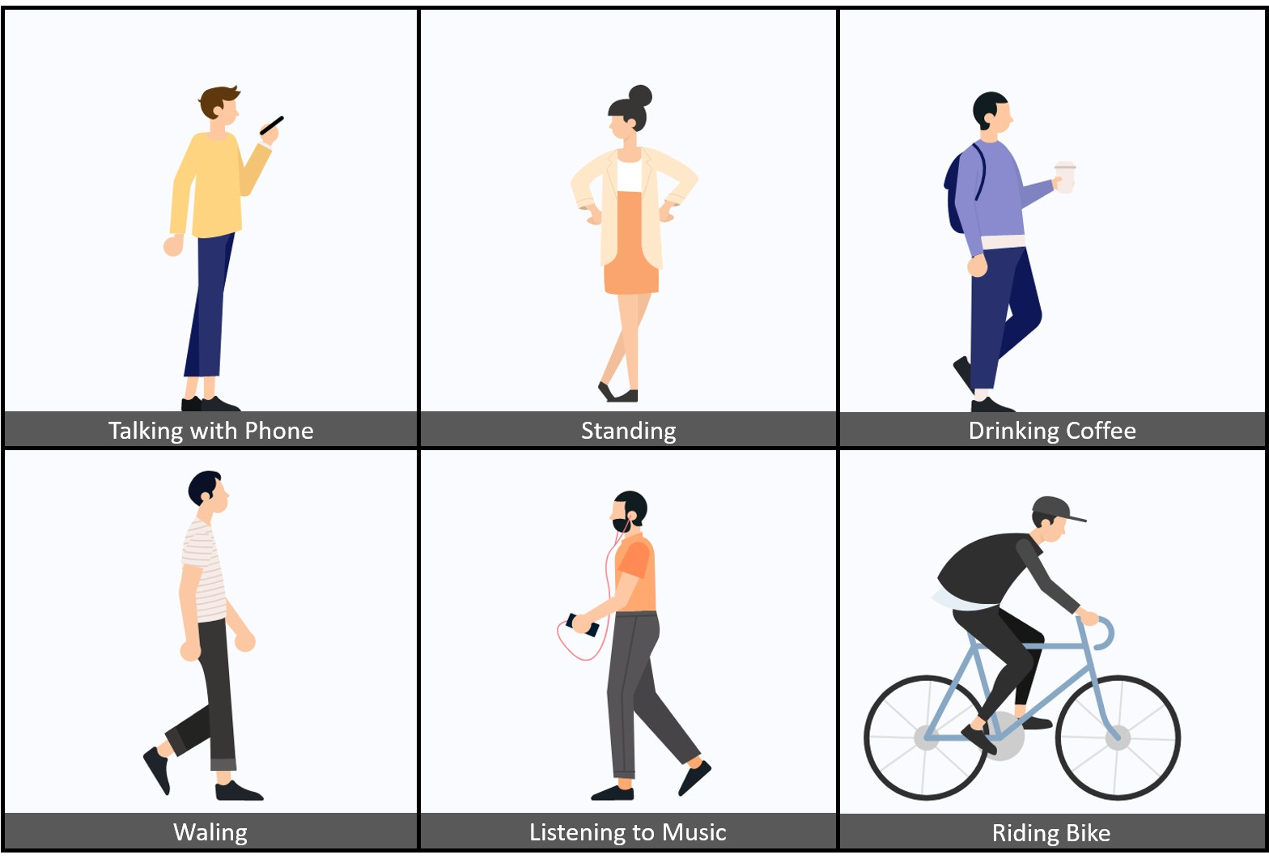
PROJECT TITLE:- Human Action Recognition
GROUP MEMBERS:-
Yash Gaikwad
Abhijeet Sawant
Tejas Jadhav

Slide 2
Table Of Contents
02
03
01
04
06
07
Screenshots
Objective
Introduction
Dataset
Models Compared
Applications

Slide 3
・01・
Objective:- The objective of this project is to build an Image Classification Model using CNN that classifies to which class of activity a human is performing.

Slide 4
・02・
Introduction -
Human Action Recognition (HAR) aims to understand human behavior and assign a label to each action. It has a wide range of applications, and therefore has been attracting increasing attention in the field of computer vision. Human actions can be represented using various data modalities, such as RGB, skeleton, depth, infrared, point cloud, event stream, audio, acceleration, radar, and Wi-Fi signal, which encode different sources of useful yet distinct information and have various advantages depending on the application scenarios.

Slide 5
・03・
About Dataset
The dataset features 15 different classes of Human Activities.
The dataset contains about 12k+ labelled images including the validation images.
Each image has only one human activity category and are saved in separate folders of the labelled classes
https://www.kaggle.com/datasets/meetnagadia/human-action-recognition-har-dataset

Slide 6
Models Compared
Inception- Accuracy=75.95
VGG16 - Accuracy=58.89
X-ception- Accuracy= 74.05
VGG19- Accuracy= 56.51
By trying different models we can see that Inception gave maximum accuracy.

Slide 7
Applications:-
1) Surveillance and Security:- HAR can be used for video surveillance systems to automatically detect suspicious activities or intruders. It can enhance security in public places, airports, and critical infrastructure facilities by recognizing abnormal behaviors.
2) Healthcare:- In healthcare settings, HAR can be applied to monitor patient activities in hospitals or at home. It can assist in the early detection of falls or other critical events, especially for elderly or vulnerable individuals.
3) Sports and Athletics:- Coaches and athletes can benefit from HAR to analyze and improve sports performance. It can be used to track and assess the form and technique of athletes in various sports.
4) Humanoid Robots:- HAR can enable robots to understand and respond to human actions, making them more versatile in assisting and collaborating with humans.

Slide 8
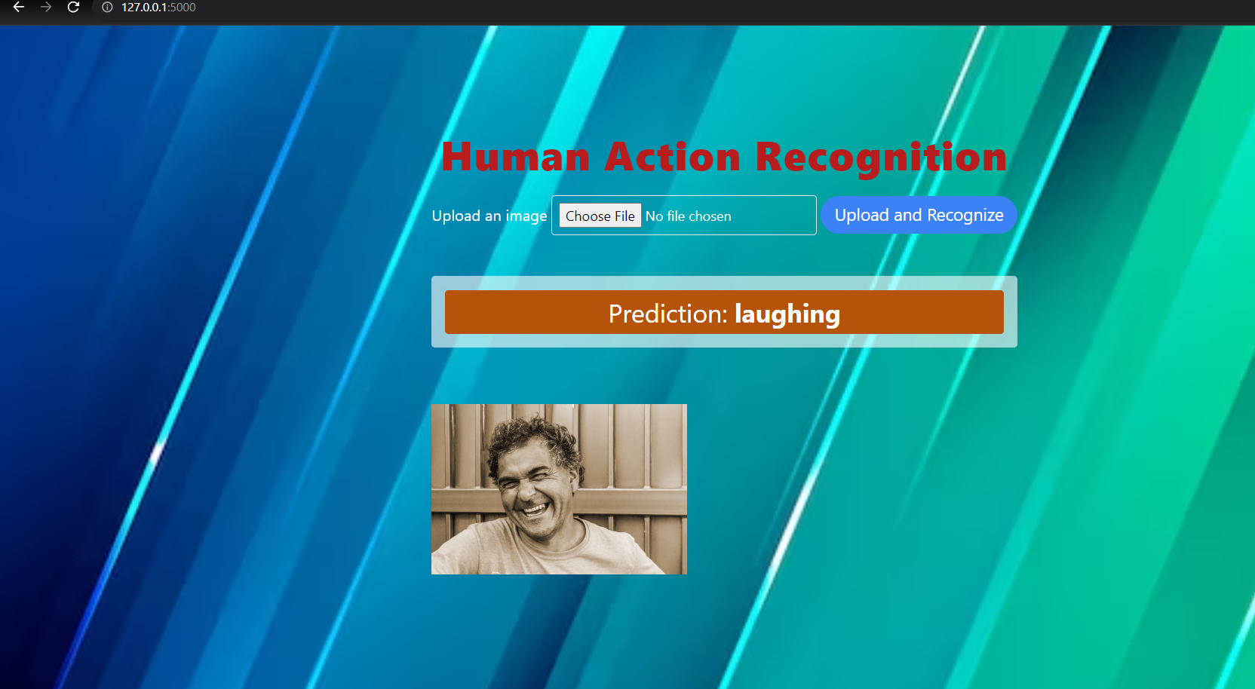
Output Screenshots

Slide 9
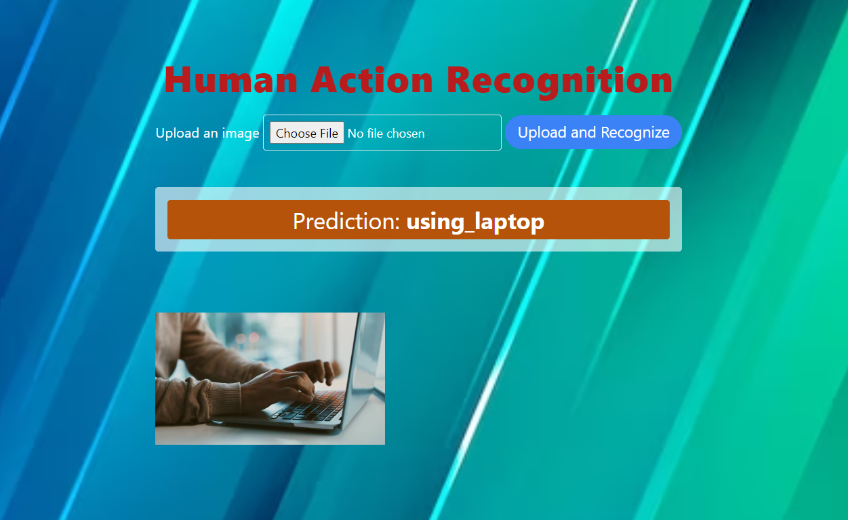

Slide 10
THANK YOU

